Slide 1
caB2B – Low Fidelity Prototype for Usability Study
6th November, 2006

Slide 2
Robert Lloyd
19th September, 2006
Logout
Security
ca Bench to Bedside (B2B)
Home
Search Data
Experiment
My Search Queries
Welcome to ca Bench to Bedside Application
The caBench-to-Bedside (caB2B) project is intended to facilitate cancer research in multiple ways.
It provides investigators with the ability to query tissue banks at multiple cancer centers, enabling studies to focus on very specific tumor subtypes and to target less common tumors by pooling bio specimen resources, and thereby attenuating the problem of small sample sizes.
It gives investigators the ability to perform novel in silico experiments using the data sets that have already been collected. These capabilities will facilitate the process of identifying genes that are up- or down-regulated in specific cancers, and allow investigators to view that data in the context of biological pathways.
In this application, you can accomplish following:
Step 1: Search Data
You can search data in various domains and add the desired data sets to an experiment.
Step 2: Create Experiment
You can filter the data and perform different analysis, visualize it using different options.
Microarray data for prostate Adenocarcinomas RNA Bio Specimen
Date: 12th November 2006
Status: In Progress
Clinico-pathology information for patients having evidence of perineural invasion
Date: 6th November 2006
Popular Search Categories
Bio Specimen
Microarray Experiments
Don’t display the above information
My Experiments
All AML
Date: 21st September, 2006
Normal Vs Diseased liver tissue
Date: 11th July, 2006
2

Slide 3
Search Module
3

Slide 4


Robert Lloyd
19th September, 2006
Logout
Security
ca Bench to Bedside (B2B)
Home
Search Data
Experiment
Search Data
1. Choose Search Category 2. Add Search Limits 3. Define Search Results Views 4. View Search Results 5. Data List
My Categories
Search
Bio Specimen
Category:
Advanced Search
My Search Queries
Category Groups(12)
Sort By: Categories
Microarray data for prostate Adenocarcinomas RNA Bio Specimen
Date: 12th November 2006
Status: In Progress
Microarray Data (15)
This category Group will provide Microarray categories.
Biospecimen Quality Control Data (2)
This category Group will provide Tissue Bank categories.
Clinico-pathology information for patients having evidence of perineural invasion
Date: 12th November 2006
Popular Categories
Bio Specimen
Micro Array Experiments
1 2 3 Next >>
Save
Select search category to move to the next step >>
4

Slide 5
Robert Lloyd
19th September, 2006
Logout
Security
ca Bench to Bedside (B2B)
Home
Search Data
Experiment
Search Data
1. Choose Search Category 2. Add Search Limits 3. Define Search Results Views 4. View Search Results 5. Data List
My Categories
Search
Bio Specimen
Category:
Advanced Search
My Search Queries
Categories (15)
Sort By: Categories
Microarray data for prostate Adenocarcinomas RNA Bio Specimen
Date: 12th November 2006
Status: In Progress
Biospecimen Quality Control Data (20)
Back
Bio Specimen
Description Description Description Description
Clinico-pathology information for patients having evidence of perineural invasion
Date: 12th November 2006
Patients
Description Description Description Description
Popular Categories
Bio Specimen
Micro Array Experiments
1 2 3 Next >>
Save
Select search category to move to the next step >>
5

Slide 6
Robert Lloyd
19th September, 2006
Logout
Security
ca Bench to Bedside (B2B)
Home
Search Data
Experiment
Search Data
1. Choose Search Category 2. Add Search Limits 3. Define Search Results Views 4. View Search Results 5. Data List
Category Search
Define Search Limits
Search
Advanced Search
Selected Category: Bio Specimen
Choose Sub Category to add
Search Criteria
Participant
Collection Protocol Registration
Specimen Collection Group
Specimen
Limit Set
Model Tree
Save
Search
Previous
Next
6

Slide 7

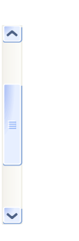


Robert Lloyd
19th September, 2006
Logout
Security
ca Bench to Bedside (B2B)
Home
Search Data
Experiment
Search Data
1. Choose Search Category 2. Add Search Limits 3. Define Search Results Views 4. View Search Results 5. Data List
Category Search
Define Search Limits for ‘Participant’
Search
Last Name:
First Name:
Middle Name:
Birth Date:
Gender:
Sex Genotype
Ethnicity:
Social Security No.:
Participant Medical Record No.:
Advanced Search
Selected Category: Bio Specimen
Choose Sub Category to add
Search Criteria
Participant
Collection Protocol Registration
Specimen Collection Group
Specimen
Add Limit
Limit Set
Participant
-
Specimen
-
Options
Options
Sex = Male
Site = Chest
Model Tree
Save
Search
Previous
Next
7

Slide 8

Robert Lloyd
19th September, 2006
Logout
Security
ca Bench to Bedside (B2B)
Home
Search Data
Experiment
Search Data
1. Choose Search Category 2. Add Search Limits 3. Define Search Results Views 4. View Search Results 5. Data List
Show All Search Results Views
Search Views available for the Search category : Bio Specimen and the rules defined are-
Bio Specimen
Description Description Description Description Description Description Description Description
Patient
Description Description Description Description Description Description Description Description
Chip
Description Description Description Description Description Description Description Description
Specimen Group
Description Description Description Description Description Description Description Description
* Default View: - Select -
Save
Previous
Next
8

Slide 9

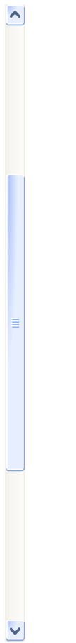
Robert Lloyd
19th September, 2006
Logout
Security
ca Bench to Bedside (B2B)
Home
Search Data
Experiment
Search Data
1. Choose Search Category 2. Add Search Limits 3. Define Search Results Views 4. View Search Results 5. Data List
Simple
Advanced
Search
Current View: Patient
Search Results 1 – 10 of 23
Select All
My Data List Summary
Smith Mary A
Female, Age: 45, Collection Protocol Registration Date : 01 November 04, Clinical Diagnosis = Lung Tumor
Doe Jane S
Female, Age: 41, Collection Protocol Registration Date : 23 October 04, Clinical Diagnosis = Lung Tumor
Ana Williams
Female, Age: 55, Collection Protocol Registration Date : 07 June 06, Clinical Diagnosis = Lung Tumor,
Maria Fernihough
Female, Age: 35, Collection Protocol Registration Date : 21 November 05, Clinical Diagnosis = Lung Tumor
Doe Jane S
Female, Age: 41, Collection Protocol Registration Date : 23 October 04, Clinical Diagnosis = Lung Tumor
Ana Williams
Female, Age: 55, Collection Protocol Registration Date : 07 June 06, Clinical Diagnosis = Lung Tumor
1 2 3 4 5 6 Next >>
Add to Data List
Apply List
Save
Previous
Next
9

Slide 10

Robert Lloyd
19th September, 2006
Logout
Security
ca Bench to Bedside (B2B)
Home
Search Data
Experiment
Search Data
1. Choose Search Category 2. Add Search Limits 3. Define Search Results Views 4. View Search Results 5. Data List
Simple
Advanced
Path: Patients > Smith Mary
‘Mari Smith’ Related Data
Smith Mary
Bio specimen
Chip
Specimen Group
Show More
Select All
Clear All
Recommended View:
View 1
Name
Birth Date
Gender
Genotype
Race
Ethnicity
My Data List Summary
Social Security Number
Collection Protocol
Clinical Status
Pathological Status
Medical Record Number
Add to Data List
Save
Previous
Next
10

Slide 11
Robert Lloyd
19th September, 2006
Logout
Security
ca Bench to Bedside (B2B)
Home
Search Data
Experiment
Search Data
1. Choose Search Category 2. Add Search Limits 3. Define Search Results Views 4. View Search Results 5. Data List
Delete
Attribute 1 Attribute 2 Attribute 3 Attribute 4
-
Patient
Smith Mary A1
Bio Specimen 1
Bio Specimen 2
Bio Specimen 3
Ana Williams
Doe Jane
Maria Fernihough
-
+
+
+
Save
Previous
Save Data List
Add to Experiment
11

Slide 12
Experiment Module
12

Slide 13

Robert Lloyd
19th September, 2006
Logout
Security
ca Bench to Bedside (B2B)
Home
Search Data
Experiment
My Experiments
Create New Experiment
Add New
Title Date Last Updated Owner
All Experiments
Mouse Experiments
Zometa Primary Tumors
NFKB1 Vs NFKB2#
Human Experiments
SNP Experiment
All AML Experiment
Normal Vs. Diseased Lever
SNP Experiment 12-Jul-2006 31-Oct-2006 Robert Lloyd
-
All AML Experiment 11-Mar-2006 12-Sept-2006 Robert Lloyd
-
Microarray Expression Analysis of Primary Versus
Metastatic Prostrate Cancer
01-Feb-2006 18-Oct-2006 Robert Lloyd
-
Tissue Experiment
Delete
13

Slide 14

Robert Lloyd
19th September, 2006
Logout
Security
ca Bench to Bedside (B2B)
Home
Search Data
Experiment
Experiment 1 Created On: 12-Jul-2006 Last Updated: 31-Oct-2006 Owner: Robert Lloyd
Add Data
Create New Experiment
Select Data Category
Create New Experiment
Visualization
Patients
Bio Specimen
Chips
1. Experiment Details 2. Select Data List 3. Summary
+
+
* Marked fields are mandatory.
+
Experiment Name:
Project:
Description:
*
Filter Data
*
Add New
Mean Standard Deviation
Annotation
Log (Base2)
Natural Log
Z-Score Normalization
Detection P Val
Inverse Signal
All Experiments
Mouse Experiments
Zometa Primary Tumors
NFKB1 Vs NFKB2#
Human Experiments
SNP Experiment
All AML Experiment
Normal Vs. Diseased Lever
-
-
-
Tissue Experiment
Create New Filter
Next
Analysis
Data View
14

Slide 15
Robert Lloyd
19th September, 2006
Logout
Security
ca Bench to Bedside (B2B)
Home
Search Data
Experiment
Experiment 1 Created On: 12-Jul-2006 Last Updated: 31-Oct-2006 Owner: Robert Lloyd
Add Data
Create New Experiment
Select Data Category
Create New Experiment
Visualization
Patients
Bio Specimen
Chips
1. Experiment Details 2. Select Data List 3. Summary
+
+
* Marked fields are mandatory.
+
My Data Lists
Experiment Data
Filter Data
Tumor Micro Array for Mouse
All AML Micro Array Data Set
Tumor Vs. Diseased Data Set for Human
Tumor Micro Array for Mouse
Mean Standard Deviation
Annotation
Log (Base2)
Natural Log
Z-Score Normalization
Detection P Val
Inverse Signal
Add All >>
Add
Remove
Create New Filter
<< Remove All
Previous
Next
Analysis
Data View
15

Slide 16

Robert Lloyd
19th September, 2006
Logout
Security
ca Bench to Bedside (B2B)
Home
Search Data
Experiment
Experiment 1 Created On: 12-Jul-2006 Last Updated: 31-Oct-2006 Owner: Robert Lloyd
Add Data
Select Data Category
Save as Data Category
Create Custom Data Category
Experiment Data
Analysis
Patients
Bio Specimens
Chips
+
Define View
+
-
Sample
Probe Sets
Probe Set Chip # 1_Signal Chip # 1_Detection Chip # 2_Signal Chip # 2_Detection
Filter Data
Detection ! = ‘A’
Z-Score Normalization > 0.5
Inverse Log2 (Signal) > 0.25
Custom Filter
Analysis
Data View
Visualization
16

Slide 17
Robert Lloyd
19th September, 2006
Logout
Security
ca Bench to Bedside (B2B)
Home
Search Data
Experiment
Experiment 1 Created On: 12-Jul-2006 Last Updated: 31-Oct-2006 Owner: Robert Lloyd
Add Data
Select Data Category
Save as Data Category
Filter Data
Experiment Data
Analysis
Filter Data by column
Signal # 1
Probe Set Chip # 1_Signal Chip # 1_Detection Chip # 2_Signal Chip # 2_Detection
-5.123 2.345
Signal # 2
-1.123 11.00
Signal # 3
-2.000
Signal # 4
A Z
Text Value 1
Text Value 2
Text Value 3
Text Value 4
Back
Analysis
Data View
Visualization
17

Slide 18
Robert Lloyd
19th September, 2006
Logout
Security
ca Bench to Bedside (B2B)
Home
Search Data
Experiment
Experiment 1 Created On: 12-Jul-2006 Last Updated: 31-Oct-2006 Owner: Robert Lloyd
Add Data
Select Data Category
Save as Data Category
Patients
Bio Specimens
Chips
+
Experiment Data
Analysis
+
-
Sample
Probe Sets
(View Analysis)
Probe Set Chip # 1_Signal Chip # 1_Detection Chip # 2_Signal Chip # 2_Detection
Filter Data
Analysis
-
Hierarchical Clustering
Cluster On Signal
Custom Clustering
K-Means
Self Organizing Maps
Consensus Clustering
Principal Component Analysis
Cluster on Z-Score
Normalization of Signal
+
+
+
+
Data View
Visualization
18

Slide 19
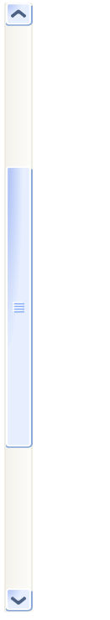
Robert Lloyd
19th September, 2006
Logout
Security
ca Bench to Bedside (B2B)
Home
Search Data
Experiment
Experiment 1 Created On: 12-Jul-2006 Last Updated: 31-Oct-2006 Owner: Robert Lloyd
Add Data
Select Data Category
Filter Data
Analysis
Data View
Chips
Chip ID Chip Name
ID 1 Chip 1
ID 2 Chip 2
ID 3 Chip 3
ID 4 Chip 4
ID 5 Chip 5
ID 6 Chip 6
ID 7 Chip 7
ID 8 Chip 8
ID 9 Chip 9
ID 10 Chip 10
ID 11 Chip 11
ID 12 Chip 12
ID 13 Chip 13
ID 14 Chip 14
ID 15 Chip 15
ID 16 Chip 16
ID 17 Chip 17
ID 18 Chip 18
ID 19 Chip 19
ID 20 Chip 20
ID 21 Chip 21
Visualization
19

Slide 20
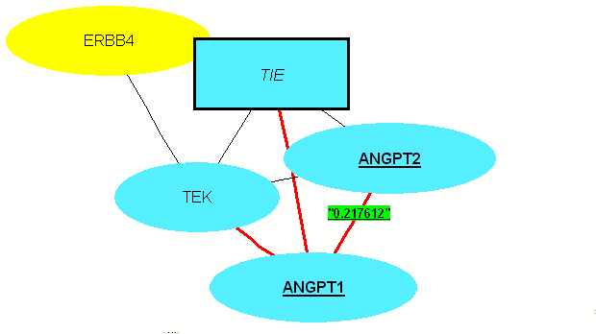
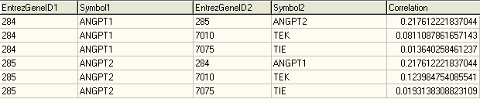

Robert Lloyd
19th September, 2006
Logout
Security
ca Bench to Bedside (B2B)
Home
Search Data
Experiment
Experiment 1 Created On: 12-Jul-2006 Last Updated: 31-Oct-2006 Owner: Robert Lloyd
Add Data
Select Data Category
Experiment Data
Analysis
Literature Network
Options
Filter Data
Analysis
Data View
Visualization
Spreadsheet
Annotation Category
Charts
Literature Network
Pathway Browser
Browser Window
Gene Annotation
Print
Export
20

Slide 21
Thank You

